Slide 1

Fundamentals of Electric Circuits
2020.3
Chapter 3
Methods of Analysis

Slide 2
Chapter3 Methods of Analysis
3.1 Motivation
3.2 Nodal analysis.
3.3 Nodal analysis with voltage sources.
3.4 Loop (Mesh )analysis.
3.5 Loop (Mesh) analysis with current sources.
3.6 Nodal versus mesh analysis.
3.7 Summary

Slide 3
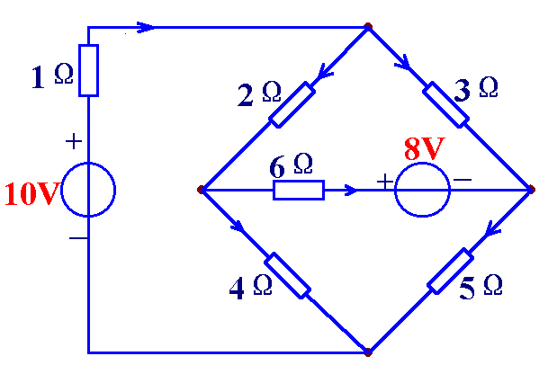
3.1 Motivation
If you are given the following circuit, how can we determine (1) the voltage across each resistor, (2) current through each resistor. (3) power generated by each current source, etc.
i₁
a
+
u₃
₋
+
u₁
-
+
u₂
-
i₃
i₂
i₆
b
c
i₄
+ u₆ -
i₅
+
u₄
₋
+
u₅
₋
d

Slide 4
Things we need to know in solving any resistive circuit with current and voltage sources only:
3.1 Motivation
Kirchhoff’s Current Laws (KCL)
Kirchhoff’s Voltage Laws (KVL)
Ohm’s Law
How should we apply these laws to determine the answers?

Slide 5




i₁
a
Example(n=4,b=6)
+
u₃
₋
+
u₁
-
+
u₂
-
i₃
i₂
i₆
b
c
i₄
+ u₆ -
i₅
+
u₄
₋
+
u₅
₋
KCL
d
a:
b:
n-1 independent KCL equations
c:
n-1 independent nodes, 1 reference node
d:

Slide 6














Example(n=4,b=6)
i₁
+
u₃
₋
+
u₁
-
+
u₂
-
i₃
i₂
KVL
i₆
i₄
+ u₆ -
i₅
+
u₄
₋
+
u₅
₋
b-(n-1) independent KVL equations
Ohm’s law:

Slide 7











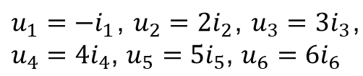

Is it possible to use fewer variables and write fewer equations？
Example(n=4,b=6)
KCL（n-1）
KCL（n-1）
KCL（n-1）
KVL（b-(n-1）)
KVL（b-(n-1）)
KVL（b-(n-1）)
Ohm’s law:
b currents and b voltages
b currents
b voltagess
2b independent equations
b independent equations
b independent equations

Slide 8
In this chapter，we will study two powerful techniques for circuit analysis. These methods are based on the above laws(Kirchhoff’s Laws, Ohm’s Law).
3.1 Motivation (2)
Nodal analysis and Mesh analysis
Please pay attention: Circuit variables, how to write equations

Slide 9
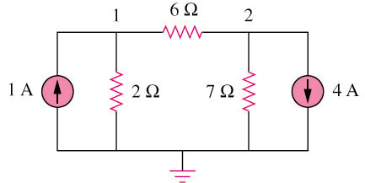
3.2 Nodal Analysis
Circuit variables：node voltages
Equations: KCL for independent nodes, replace current with node voltages
Example 1
3
2 independent nodes, 1 reference node
We can select node 3 as reference node.

Slide 10
3.2 Nodal Analysis (2)
Steps to determine the node voltages:
  Select a node as the reference node.
  Assign voltages v₁,v₂,…,v_{n-1} to the remaining n-1 nodes. The voltages are referenced with respect to the reference node.
  Apply KCL to each of the n-1 non-reference nodes. Use Ohm’s law to express the branch currents in terms of node voltages.
  Solve the resulting simultaneous equations to obtain the unknown node voltages.

Slide 11
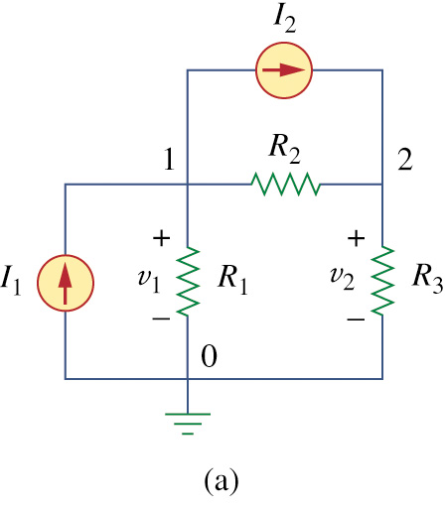
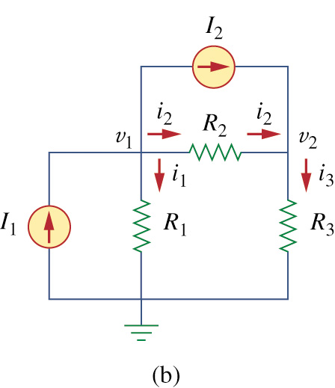
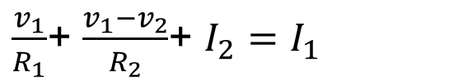
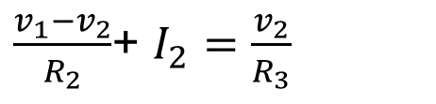
1.Select node 0 as reference node, assigned voltages v₁ and v₂ ,respectively.
2.Applying KCL to node 1 and node 2.
Suppose each resister’s voltage and current are passive sign convention.
At Node 1 and node 2

Slide 12

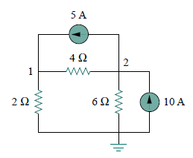



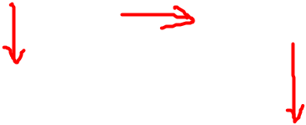

3.2 Nodal Analysis (3)
Example 3 – Calculate the node voltages in the circuit shown in Fig. 3.3(a).
circuit independent current source only
At Node 1
At Node 2
So
Fig. 3.3(a) original circuit.

Slide 13
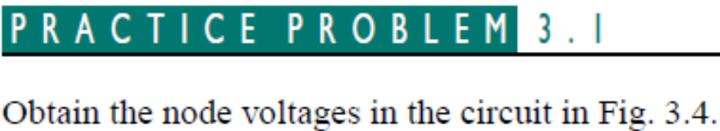
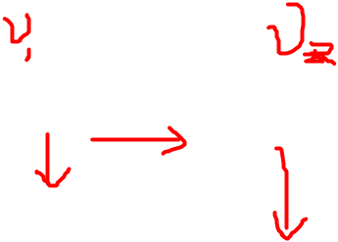
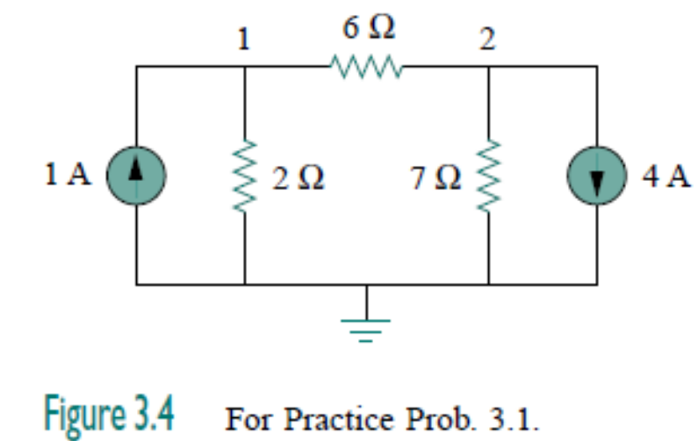

Slide 14
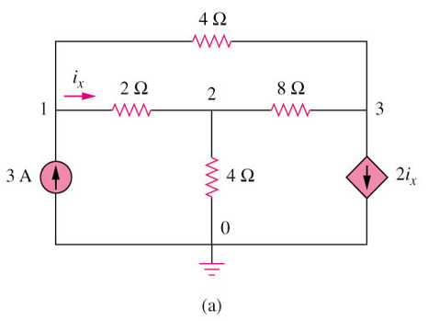







3.2 Nodal Analysis (4)
Example 3 – current with dependant current source
  Write the equation that specifies the relationship of the dependent source to the controlling parameter.

Slide 15
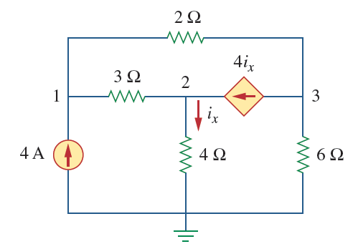
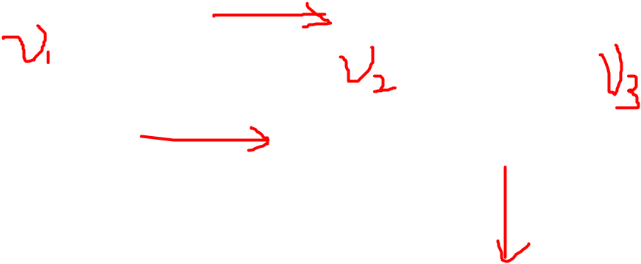


Slide 16

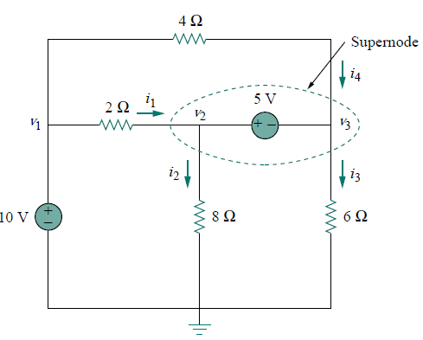


3.3 Nodal Analysis with Voltage Source (1)
If a voltage source is connected between the reference node and a nonreference node, we simply set the voltage at the nonreference node equal to the voltage of the voltage source.
Thus our analysis is somewhat simplified by this knowledge of the voltage at this node.

Slide 17
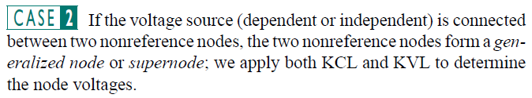
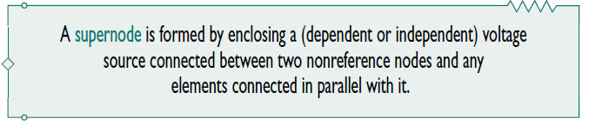
  (1) Apply KCL to super-nodes;
  (2) Write the equation that defines the voltage relationship between the two nonreference nodes as a result of the presences of the voltage source.

Slide 18
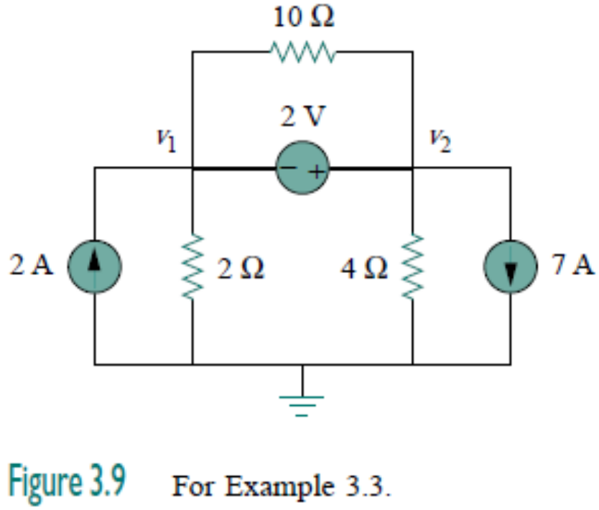
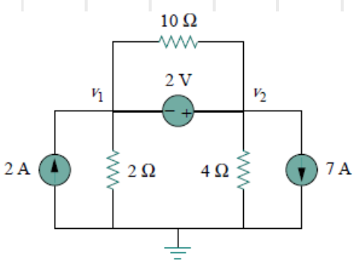

3.3 Nodal Analysis with Voltage Source (2)
Example 5 – For the circuit shown in Fig. 3.9, find the node voltages
v₂ -v₁= 2

Slide 19
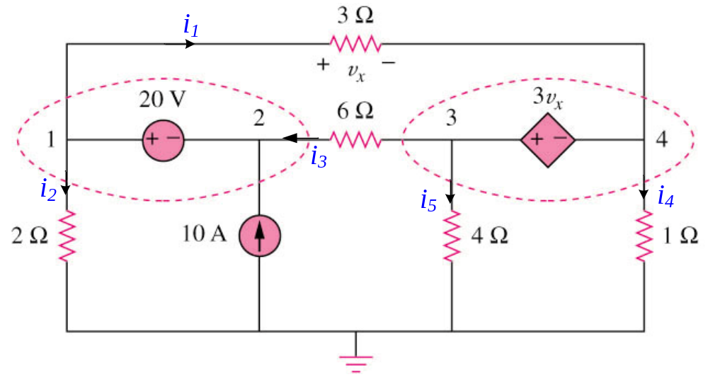


3.3 Nodal Analysis with Voltage Source (4)
Example 7 – circuit with one independent voltage source and one dependent voltage source
supernode 1
supernode 2
Supernode1,
Supernode2,
v₁-v₂ = 20
v₃ - v₄ = 3v_{x}
v₁ - v₄ = v_{x}

Slide 20
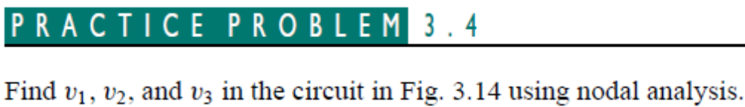
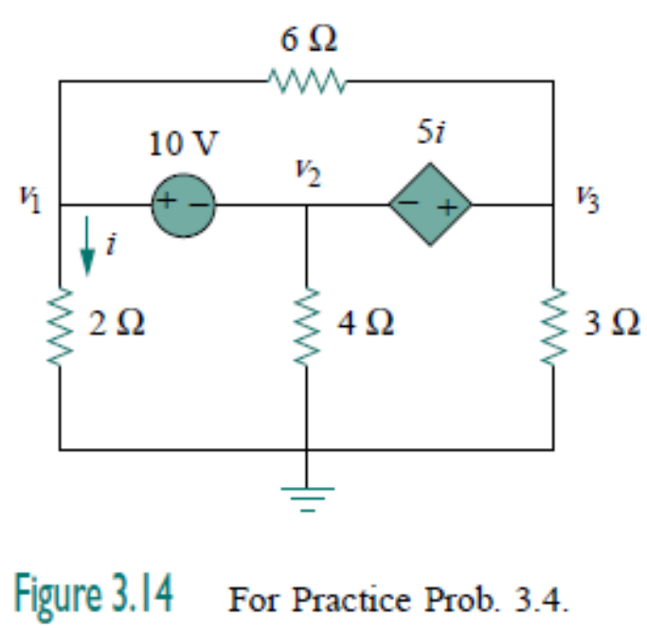

Slide 21
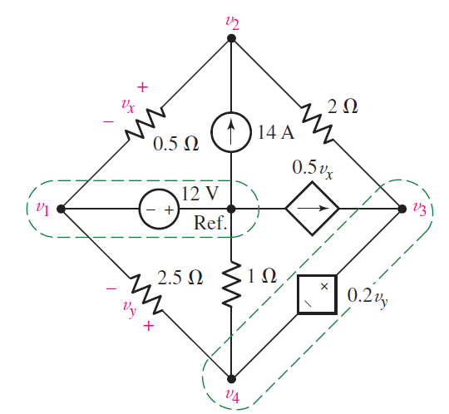










Slide 22

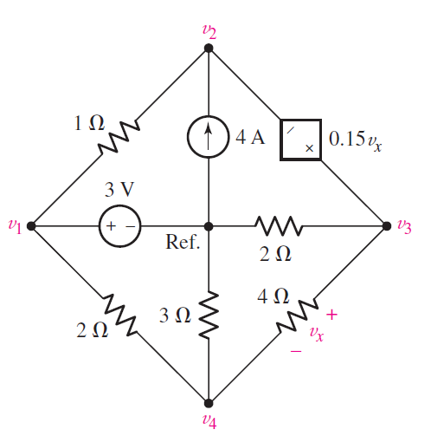

Slide 23
Summary of last class
Nodal analysis method
Circuit variables：node voltages
Equations: KCL for independent nodes, replace current with node voltages
Steps to determine the node voltages:
  Select the reference node.
  Assign node voltages v₁,v₂,…,v_{n-1} to the remaining n-1 nodes.
  Apply KCL to each of the n-1 non-reference nodes.
  Use Ohm’s law to express the branch currents in terms of node voltages.
  Solve the equations to obtain the unknown node voltages.
  Compute branch(element) currents and voltages.

Slide 24
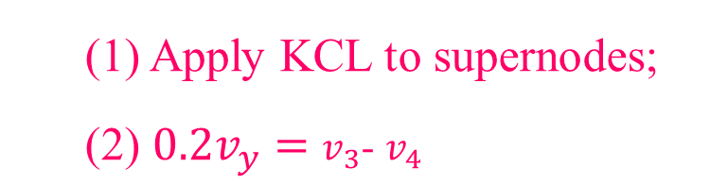
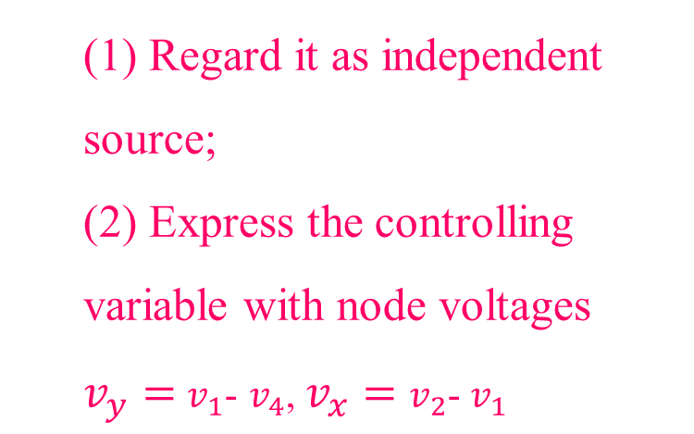

Special cases:
Case 2: A voltage source is connected between two nonreference nodes
Select supernode
Case 1
Case 2
Case 3: dependent sources
Case 3
Case 1: A voltage source is connected between the reference node and a nonreference node

Slide 25












branch(element) currents and voltages
i₁
a
+
u₃
₋
+
u₁
-
+
u₂
-
i₃
i₂
i₆
b
c
i₄
+ u₆ -
i₅
+
u₄
₋
+
u₅
₋
d

Slide 26
3.4 Mesh Analysis
1.Mesh
A mesh is a loop which does not contain any other loops within it.
2.Mesh current
We define a mesh current as a current that flows only around the perimeter of a mesh.
Circuit variables：
Mesh current
Equations: KVL for meshes, replace voltage with Mesh current
i₄
i₂
i₁
I_{b}
i₆
I_{a}
i₅
  We should notice that the mesh current is imaginative, not measurable directly.
i₃
I_{c}

Slide 27
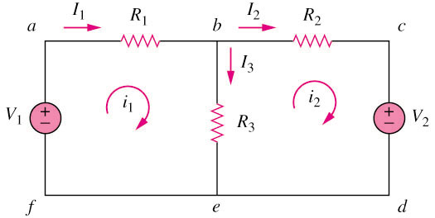
3.4 Mesh Analysis
Example 8 – circuit with independent voltage sources
1.Assign mesh currents i₁, i₂, …, in to the n meshes.
Note:
i₁ and i₂ are mesh current (imaginative, not measurable directly)
I₁, I₂ and I₃ are branch current (real, measurable directly)
I₁ = i₁; I₂ = i₂; I₃ = i₁ - i₂

Slide 28



2. Apply KVL to each of the n meshes. Use Ohm’s law to express the voltages in terms of the mesh currents.
Applying KVL to mesh 1,
Applying KVL to mesh 2,
3. Solve the resulting 2 simultaneous equations to get the mesh currents.

Slide 29
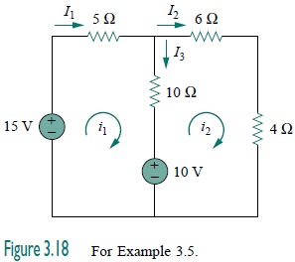


EXAMPLE 3.5 For the circuit in Fig. 3.18, find the branch currents I₁ , I₂ , and I₃ using mesh analysis.
Solution:
For mesh 1,
So

Slide 30
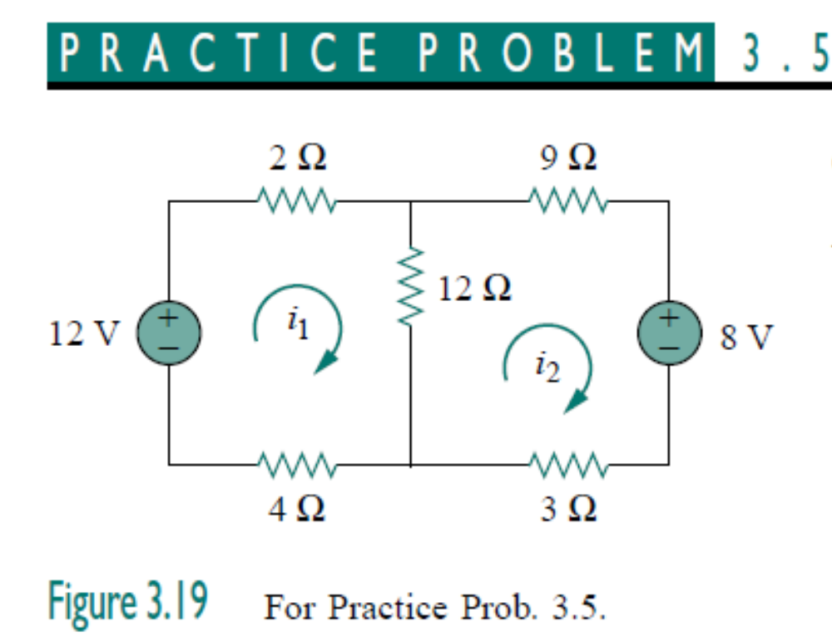
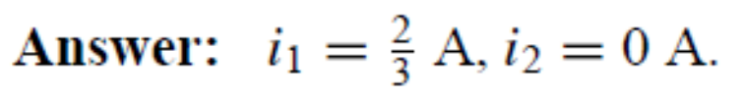
Calculate the mesh currents i₁ and i₂ in the circuit of Fig. 3.19.

Slide 31
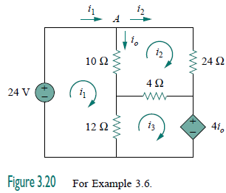
3.4 Mesh Analysis
Dependent sources
Method: First, treat dependent sources as an independent source when writing the KVL equations. Then write the controlling equation for the dependent source.

Slide 32

EXAMPLE 3.6 Use mesh analysis to find the current i_{o} in the circuit in Fig. 3.20.
Solution:
Apply KVL to the three meshes in turn.
For mesh 1,
For mesh 2,
For mesh 3,

Slide 33
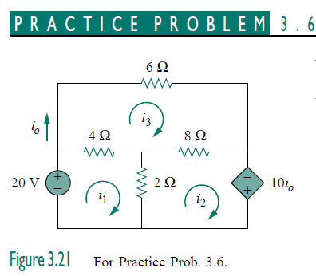

Using mesh analysis, find i_{o} in the circuit in Fig. 3.21.

Slide 34
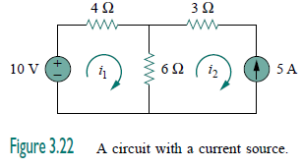

3.5 Mesh Analysis with Current Source
Case 1. When a current source exists only in one mesh.
For the mesh containing the current source, its mesh current is known.
Case 1
Set i₂ = −5 A
For other meshes, write the mesh current equation using KVL.

Slide 35
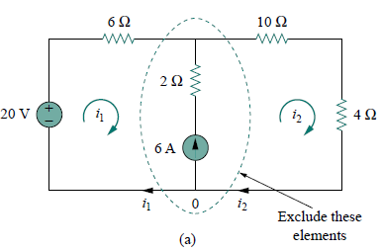
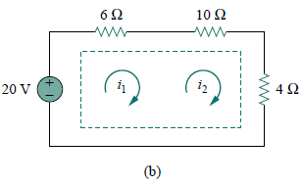
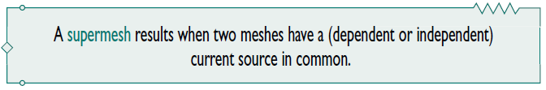
Case 2. A current source exists between two meshes .
supermesh
We create a supermesh by excluding the current source and any elements connected in series with it, as shown in Fig. 3.23(b).

Slide 36


Case 2. A current source exists between two meshes .
Applying KVL to the supermesh
Apply KCL to a node in the branch where the two meshes intersect.
Applying KCL to node 0,
A super-mesh requires the application of both KVL and KCL!

Slide 37
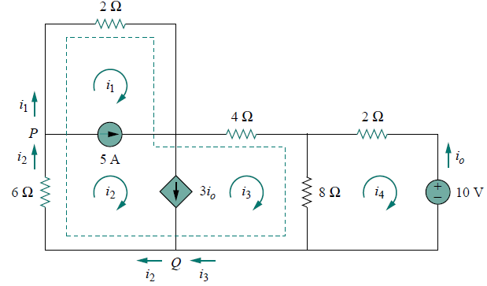





If a circuit has two or more supermeshes that intersect, they should be combined to form a larger supermesh.
For the circuit, find i₁ to i₄ using mesh analysis.
Applying KVL to the larger supermesh,
Applying KCL to node P:
Applying KCL to node Q:
Applying KVL in mesh 4,

Slide 38
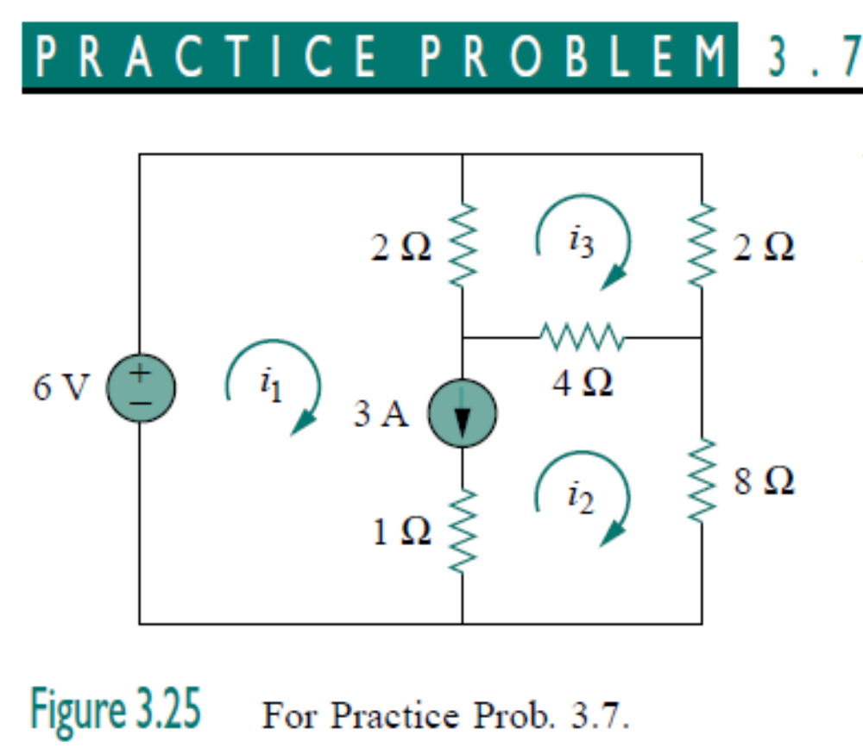
Use mesh analysis to determine i₁, i₂, and i₃ in Fig. 3.25.

Slide 39
3.6 Nodal versus Mesh Analysis (1)
To select the method that results in the smaller number of equations. For example:
Choose nodal analysis for circuit with fewer nodes than meshes.
Choose mesh analysis for circuit with fewer meshes than nodes.
  *Networks that contain many series-connected elements, voltage sources, or supermeshes are more suitable for mesh analysis.
  *Networks with parallel-connected elements, current sources, or supernodes are more suitable for nodal analysis.
2. If node voltages are required, it may be expedient to apply nodal analysis. If branch or mesh currents are required, it may be better to use mesh analysis.

Slide 40
3.7 Summary and Review
Nodal analysis:
If nodal analysis is the chosen approach, choose one of the nodes as a reference node. Then label the node voltage v₁, v₂, …, v_{N-1}, remembering that each is understood to be measured with respect to the reference node.
If the circuit contains only current sources, apply KCL at each nonreference node.
If the circuit contains voltages sources, form a supernode about each one, and then proceed to apply KVL at all nonreference nodes and supernodes.

Slide 41
Mesh analysis:
Assign a clockwise mesh current in each mesh: i₁, i₂, …, i_{M}.
If the circuit contains only voltage sources, apply KVL around each mesh.
If the circuit contains current sources, create a supermesh for each one current source that is common to two meshes, and then apply KVL around each mesh and supermesh.

